Slide 1
Stage Theories of Psychology - Piaget

Slide 2
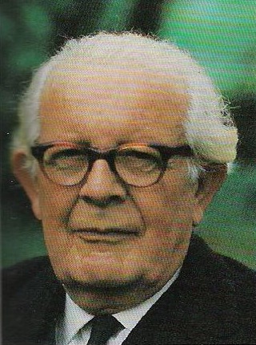
Jean Piaget
Cognitive development theory
Children "construct" their understanding of the world through their active involvement and interactions.
Studied his 3 children to focus not on what they knew but how they knew it.
Described children's understanding as their "schemas” and how they use:
assimilation
accommodation.

Slide 3
Piaget’s Theory of Cognitive Development
Piaget did not conduct formal experiments, but rather loosely structured interviews in which he posed problems for children to solve, observed their actions carefully, and questioned them about their solutions
Was particularly interested in children’s error, which would provide insights into children’s thought processes
Assumed that a child is an active seeker of knowledge and gains an understanding of the world by operating on it

Slide 4
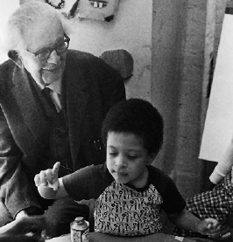
Schemas
Organized units of knowledge about objects, events, and actions
Cognitive adaptation
involves two processes
Assimilation is the interpretation of new
experiences in terms of present schemes
Accommodation is the
modification of present schemes to fit with new experiences

Slide 5


Schemas
For example, a child may call all four-legged creatures “doggie”
The child learns he needs to accommodate (i.e., change) his schemes, as only one type of four-legged creature is “dog”
It is through accommodation that the number and complexity of a child’s schemes increase and learning occurs

Slide 6
Piaget’s Stages of Cognitive Development
Sensorimotor | Birth to 2 years
Preoperational | 2 to 6 years
Concrete operational | 6 to 12 years
Formal operational | 12+ years

Slide 7
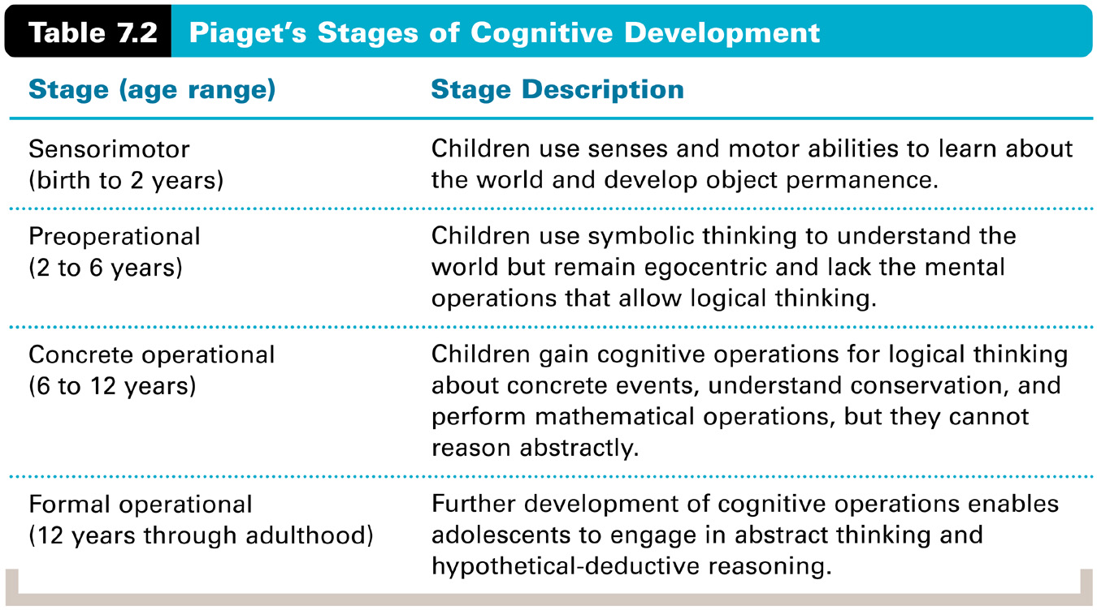
Piaget’s Stages of Cognitive Development

Slide 8
Sensorimotor Stage
Infant learns about the world through their sensory and motor interactions (including reflexes)
Lack object permanence, the knowledge than an object exists independent of perceptual contact
Symbolic representation of objects and events starts to develop during the latter part of the sensorimotor stage (e.g., use of telegraphic speech)

Slide 9
Preoperational Stage
The child’s thinking becomes more symbolic and language-based, but remains egocentric and lacks the mental operations that allow logical thinking
Egocentrism is the inability to distinguish one’s own perceptions, thoughts, and feelings from those of others
Cannot perceive the world from another person’s perspective
The child, however, can pretend, imagine, and engage in make-believe play

Slide 10
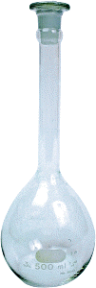
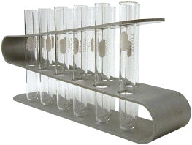
Preoperational Stage
Conservation is the knowledge that the quantitative properties of an object (such as mass, volume, and number) remain the same despite changes in appearance
Some grasp of conservation marks the end of the preoperational stage and the beginning of the concrete-operational stage
The liquid/beakers problem is a common test of conservation ability

Slide 11
Preoperational Stage
A major reason why a preoperational child does not understand conservation is that the child lacks an understanding of reversibility, the knowledge that reversing a transformation brings about the conditions that existed before the transformation
Child’s thinking also reflects centration, the tendency to focus on only one aspect of a problem at a time

Slide 12
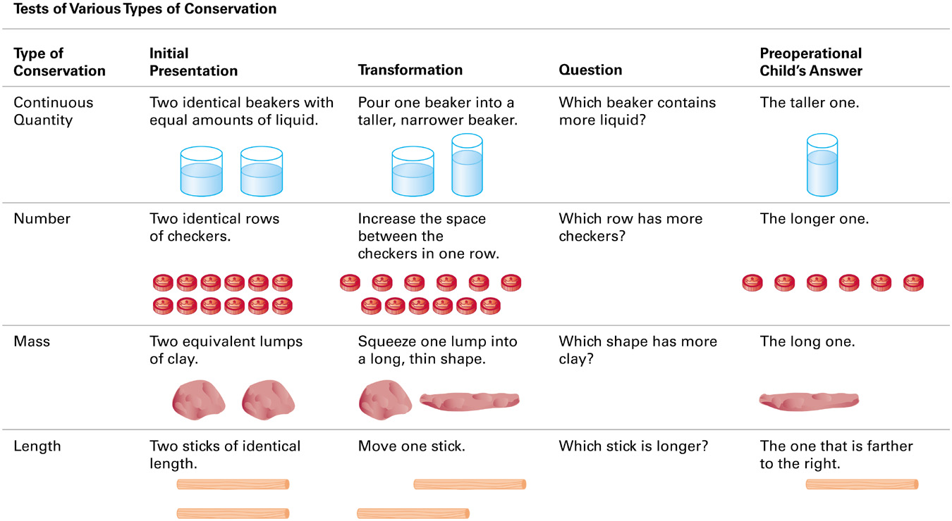
Tests of Conservation

Slide 13
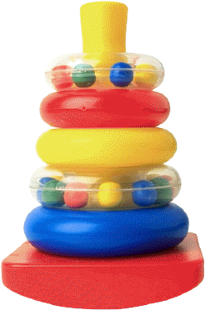
Concrete Operational Stage
Children gain a fuller understanding of conservation and other mental operations that allow them to think logically, but only about concrete events
Conservation for liquids, numbers, and matter acquired early, but conservation of length acquired later in the stage
Develops transitivity (e.g., if A > B, and B > C, then A > C)
Develops seriation, the ability to order stimuli along a quantitative dimension (e.g., a set of pencils by their length)
The reasoning of concrete operational children is tied to immediate reality (i.e., what is in front of them and tangible) and not with the hypothetical world of possibility

Slide 14
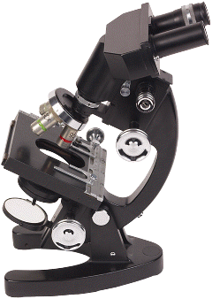
Formal Operational Stage
The child gains the capacity for hypothetical-deductive thought
Can engage in hypothetical thought and in systematic deduction and testing of hypotheses

Slide 15
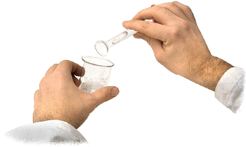
Formal Operational Stage
In one scientific thinking task, the child is shown several flasks of what appear to be the same clear liquid and is told one combination of two of these liquids would produce a clear liquid
The task is to determine which combination would produce the blue liquid
The concrete operational child just starts mixing different clear liquids together haphazardly
The formal operational child develops a systematic plan for deducing what the correct combination must be by determining all of the possible combinations and then systematically testing each one

Slide 16
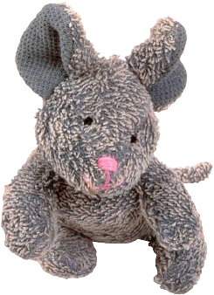
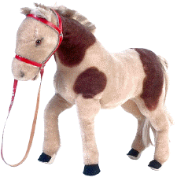
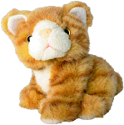
Formal Operational Stage
The formal operational child can evaluate the logic of verbal statements without referring to concrete situations
For example, the formal operational child would judge the statement “If mice are bigger than horses, and horses are bigger than cats, then mice are bigger than cats” to be true, even though in “real life” mice are not bigger than cats

Slide 17
Evaluation of Piaget’s Theory
Recent research has shown that rudiments of many of Piaget’s key concepts (e.g., object permanence) may begin to appear at earlier stages than Piaget proposed
For example, research that involved tracking infants’ eye movements has found that infants as young as 3 months continue to stare at the place where the object disappeared from sight, indicating some degree of object permanence
Piaget did not include the influence of others. It was later suggested that interaction with others can influence the RATE of development

Slide 18
Evaluation of Piaget’s Theory
Not all people reach formal operational thought
The theory may be biased in favor of Western culture
There is no real theory of what occurs after the onset of adolescence
Overall - Despite refinements, recent research has indeed shown that cognitive development seems to proceed in the general sequence of stages that Piaget proposed
i.e. sequence of milestones agreed upon but not necessarily the age.

Slide 19
Criticisms of validity
Unfamiliar materials and situations
Hughes’ policeman task – children showed ability to take other’s point of view in a mare familiar situation. Suggested that the mountains were too abstract
Language used is not conversational
Siegal suggested the questions posed broke normal rules of conversation e.g. asking questions when the answers are ‘obvious’. Also suggested they could change answers to please the experimenter
Competence vs Performance
Suggested children can do the reasoning but not explain to the experimenter well enough
Education vs development
Seagrim – experimented with Aboriginal children – those raised in western schooling did better – cultural effects?

